Slide 1
MongoDB (III): Retail

Slide 2
Recap on MongoDB
Open-source document database
Provides high performance, high availability, and automatic scaling
Classified as a NoSQL database program, MongoDB uses JSON-like documents with schemas
Developed by MongoDB Inc. and initially released in 2009
Written in C, C++, and JavaScript

Slide 3
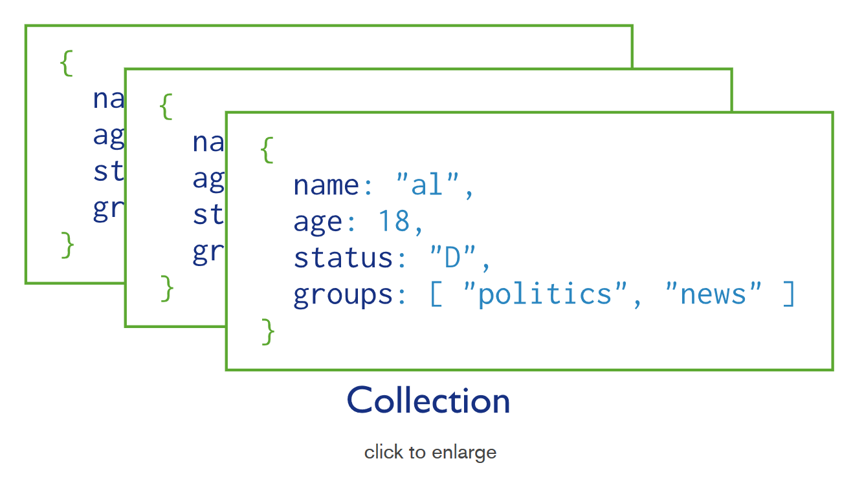
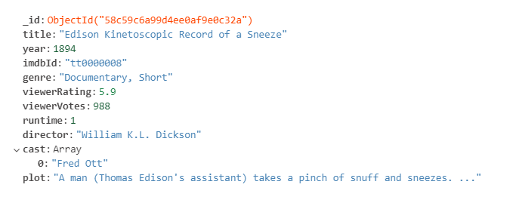
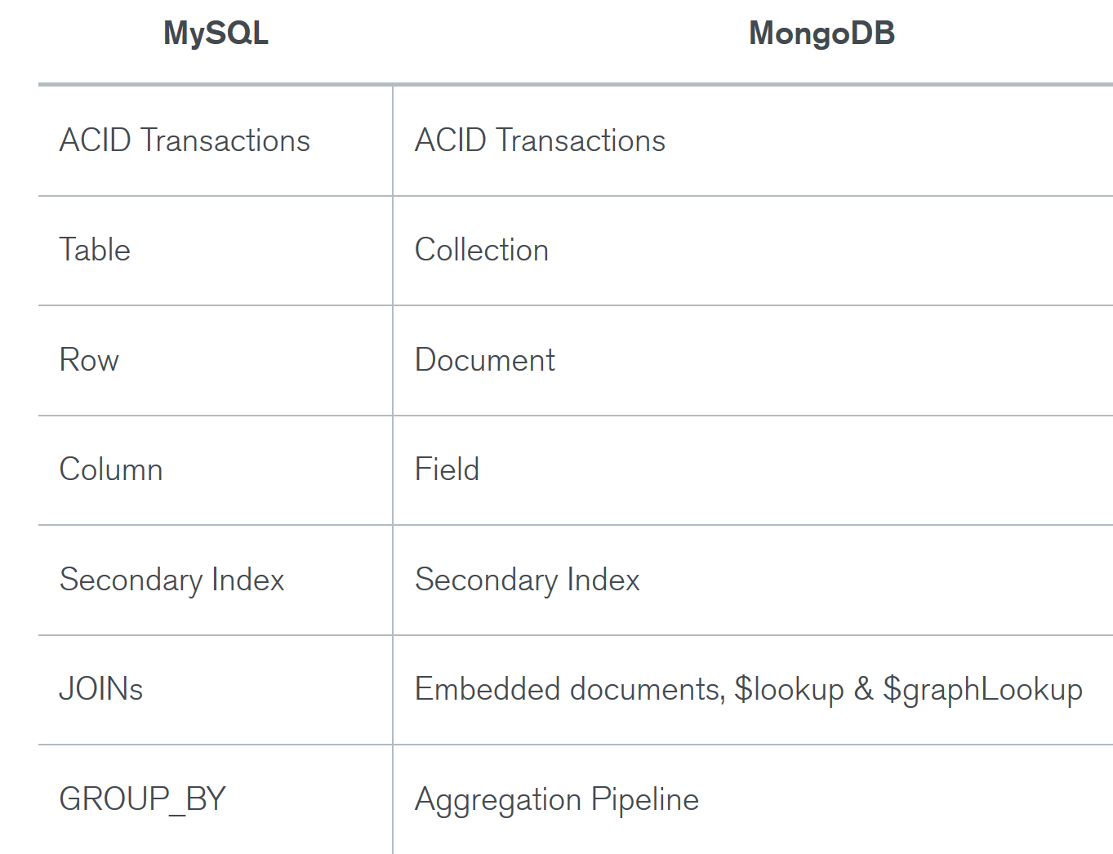
Recap on MongoDB
Record in MongoDB is a document, which is a data structure composed of field and value pairs.
These documents in MongoDB are similar to JSON objects. The values of fields may include other documents, arrays, and arrays of documents.

Slide 4
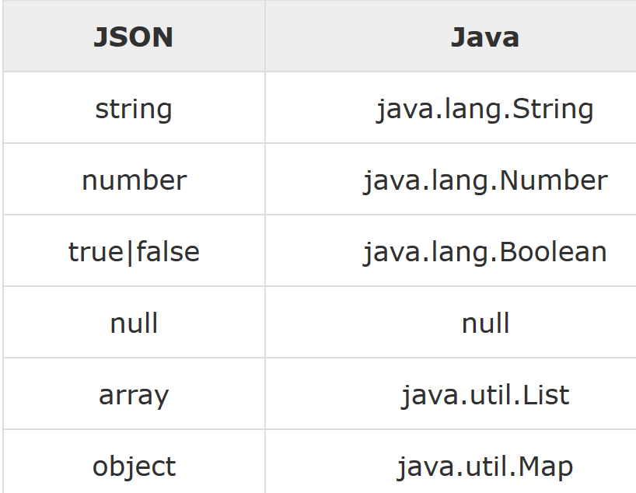
Recap: Advantages of using Documents
Documents in MongoDB relate to many native data types in most programming languages
Embedded documents are less expensive than joins
Polymorphism is supported by dynamic schema
human
student
undergrad
grad
teacher
admin

Slide 5
Recap: Key Features of MongoDB
High Performance
Support for embedded data models reduces I/O on DB
Rich Query Language
High Availability
MongoDB’s replication facility, replica set, provides:
automatic failover and
data redundancy.
Horizontal Scalability
Sharding distributes data across a cluster of machines.

Slide 6
MongoDB Compass
MongoDB Compass acts as a GUI for MongoDB.
Through Compass, you can visually explore your dataset and view and optimize your query performance.
The Compass GUI is available as an option while installing MongoDB

Slide 7
MongoDB Compass installation
Please see the installation and more details of MongoDB Compass in the Appendix of this slide.
Please install MongoDB Compass Community Version (free version): https://www.mongodb.com/download-center?jmp=hero#compass
Most of the below queries can also be implemented in MongoDB command line or other GUI tools for both Windows and Mac.

Slide 8
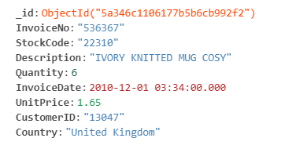

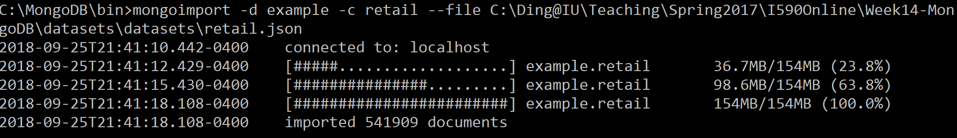
Dataset: Retail
Here we demonstrate some of the advanced pipeline operators through an example
Dataset used: retail.json (Sample collection in MongoDB Atlas databases)

Slide 9
Dataset Details:
Field | Description
_id | Object Id. Added as the default index by MongoDB.
Country | Specifies the country of the retail store
Customer ID | Specifies the customer ID
Description | Provides a description of the item bought
InvoiceDate | Provides the date of the purchase
InvoiceNo | Provides the invoice number/id
Quantity | Specifies the quantity of the item bought
StockCode | Provides a code for the item stock
UnitPrice | Provides the price of each unit of the item

Slide 10
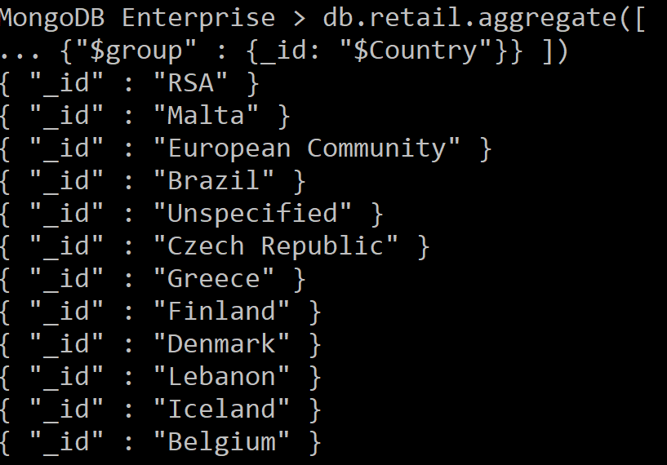
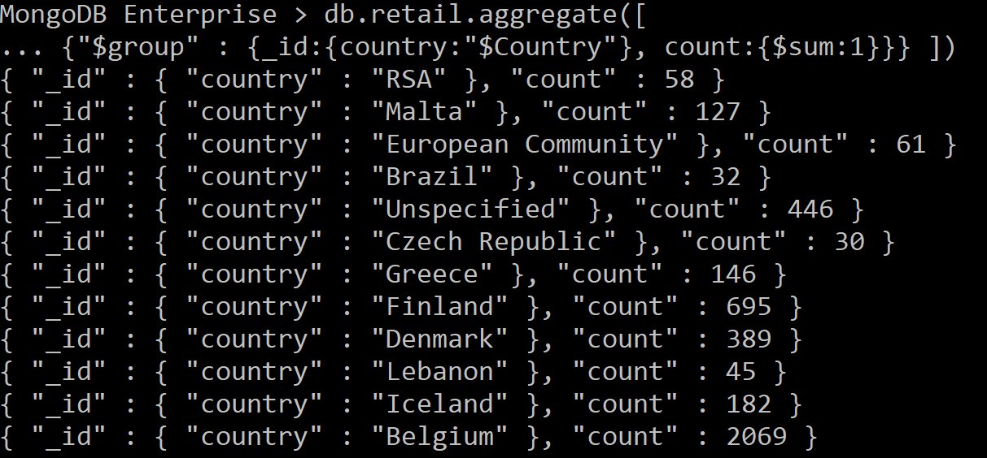
Understanding retail
db.retail.aggregate([
{"$group" : {_id: "$Country"}} ])
db.retail.distinct('Country')
db.retail.aggregate([
{"$group" : {_id:{country:"$Country"}, count:{$sum:1}}} ])

Slide 11
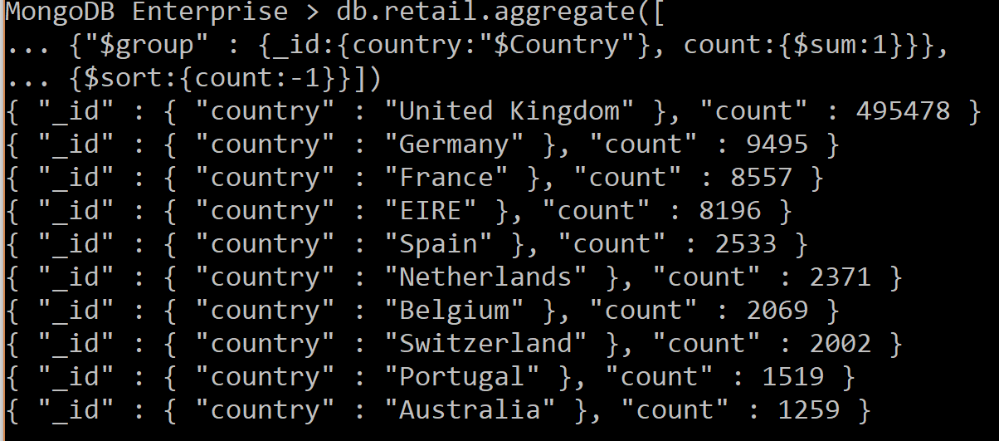
Understanding retail
db.retail.aggregate([
{"$group" : {_id:{country:"$Country"}, count:{$sum:1}}},
{$sort:{count:-1}}])
db.retail.distinct("Country")

Slide 12
Operators in MongoDB
Query and Projection Operators
Query operators provide ways to locate data within the database and projection operators modify how data is presented.
Comparison, Logical, Element, Evaluation, Geospatial, Array, Bitwise, Comments, Projection Operators
Update Operators
Update operators are operators that enable you to modify the data in your database or add additional data.
Fields, Array, Bitwise, Modifiers
Aggregation Pipeline Operators
Aggregation pipeline operations have a collection of operators available to define and manipulate documents in pipeline stages.
Arithmetic Expression, Array Expression, Boolean Expression, Comparison Expression, Conditional Expression, etc.
Query Modifiers
Query modifiers determine the way that queries will be executed.

Slide 13
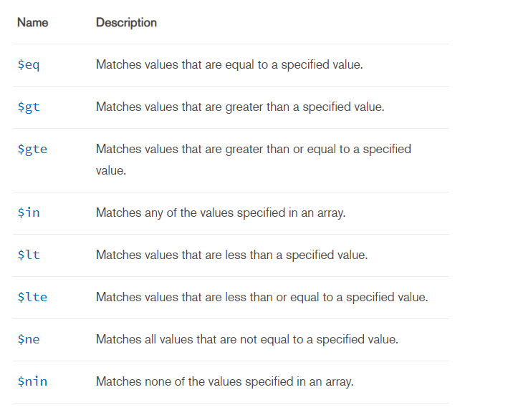
Query Selectors: Comparison Operators

Slide 14
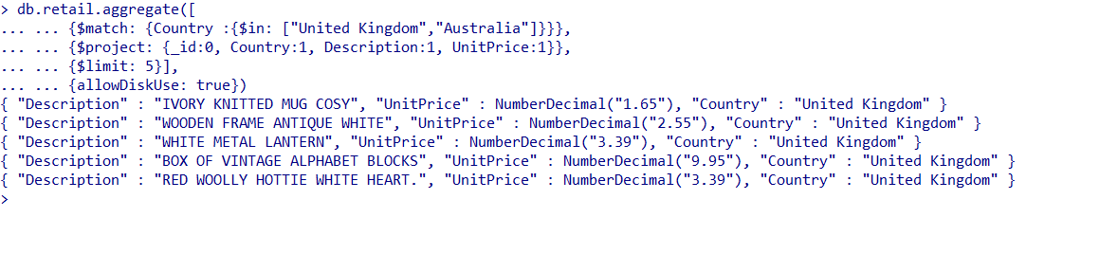
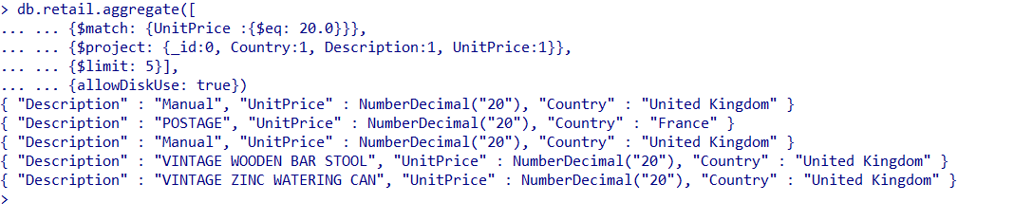
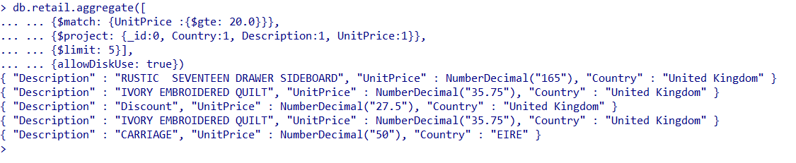
Query Selectors: Comparison Operators
$in
db.retail.aggregate([
{$match: {Country: {$in: ["United Kingdom", "Australia"]}}},
{$project: {_id:0, Country:1, Description:1, UnitPrice:1}},
{$limit: 5}], {allowDiskUse: true})
Given here are some examples of Comparison operators being used in Aggregation queries in MongoDB
In the first example, $in is being used to retain records for the following countries : United Kingdom, Australia
In the second example, $eq operator is being used to retain records where the unit price is 20
In the third example, $gte operator is being used to retain records where the unit price is greater than or equal to 20
$eq
db.retail.aggregate([
{$match: {UnitPrice: {$eq: 20.0}}},
{$project: {_id:0, Country:1, Description:1, UnitPrice:1}},
{$limit: 5}], {allowDiskUse: true})
$gte
db.retail.aggregate([
{$match: {UnitPrice: {$gte: 20.0}}},
{$project: {_id:0, Country:1, Description:1, UnitPrice:1}},
{$limit: 5}], {allowDiskUse: true})

Slide 15
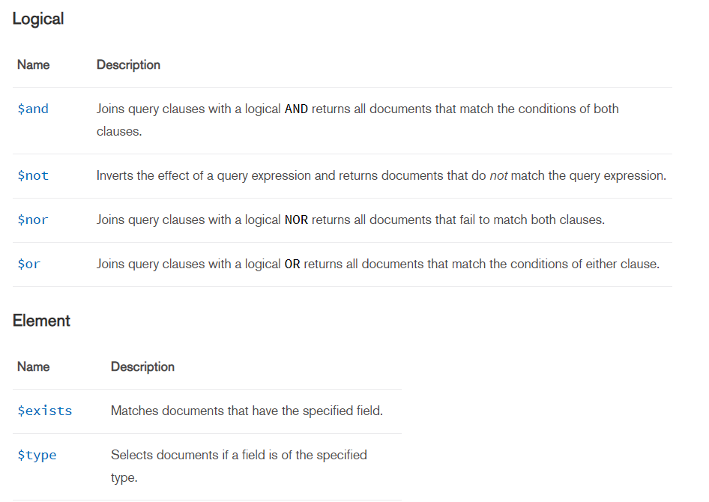
Query Selectors: Logical and Element Operators

Slide 16
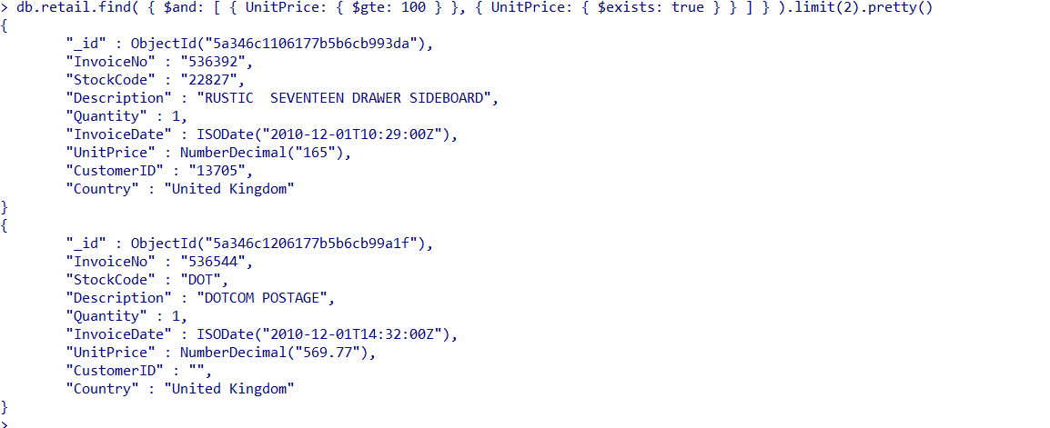
Query Selectors: Logical and Element Operators
$and, $exists
Given here is an example of the logical operator $and and the element operator $exists.
The operators here are being used to find records where the unit price attribute exists and is greater than or equal to 100
db.retail.find(
{$and: [{UnitPrice: {$gte: 100}}, {UnitPrice: {$exists: true}}]}
).limit(2).pretty()

Slide 17
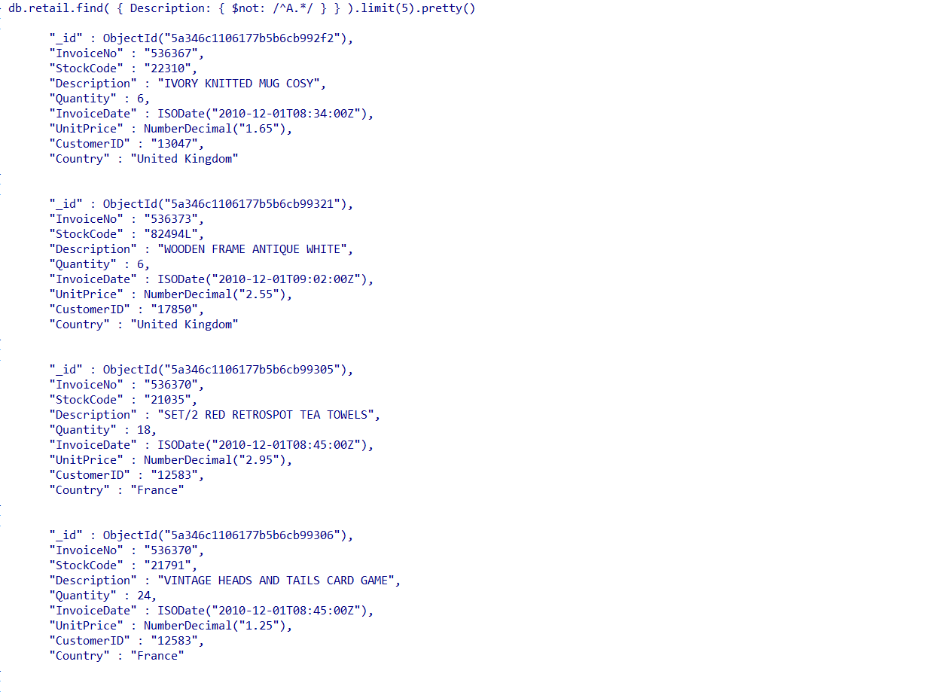
Query Selectors: Logical and Element Operators
$not
db.retail.find({Description: {$not: /^A.*/}}).limit(5).pretty()
Given here is an example of the logical operator $not
It is being used to find records of items which do not begin with the alphabet ‘A’

Slide 18
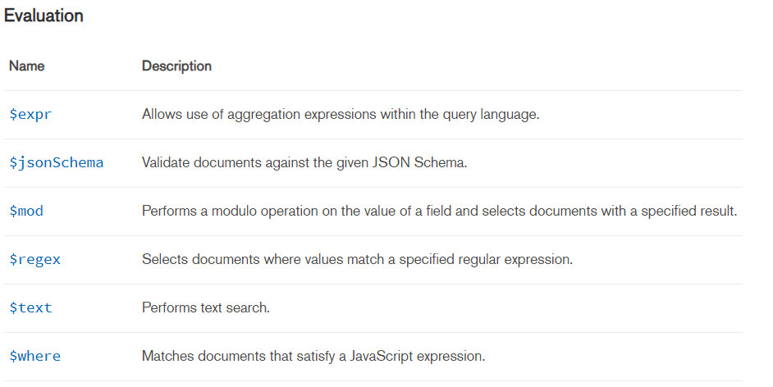
Query Selectors: Evaluation Operators

Slide 19
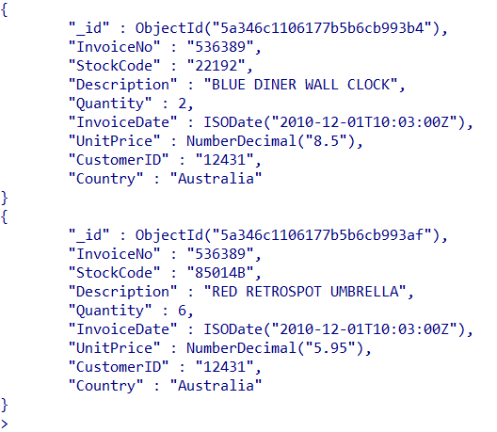
Query Selectors: Evaluation Operators
$where
db.retail.find({$where: function(){return (this.Country == "Australia")}}).limit(2).pretty()
Here, we are using the $where operator to find records where the country is Australia.
The records have further been limited by .limit() and made more readable using .pretty()

Slide 20
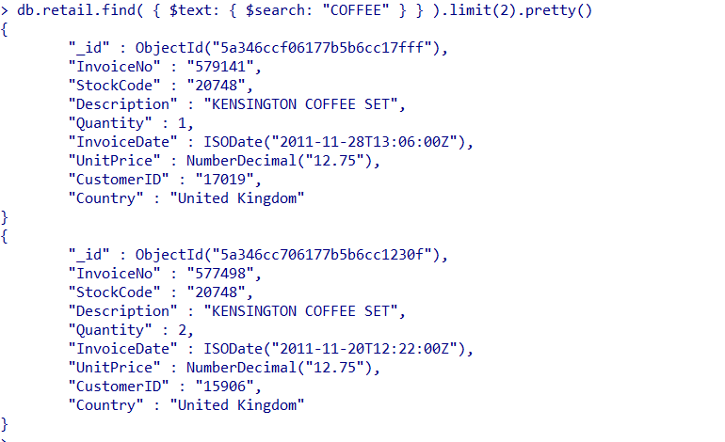
Query Selectors: Evaluation Operators
$text
db.retail.createIndex({Description: "text"})
db.retail.find({$text: {$search: "COFFEE"}}).limit(2).pretty()
Here we use the $text operator for text matching purposes.
$text performs a text search on the content of the fields indexed with a text index.
To use the operator, we first define a text index on the field Description
We can now use $text to look for a specific text in that field and filter records accordingly.

Slide 21
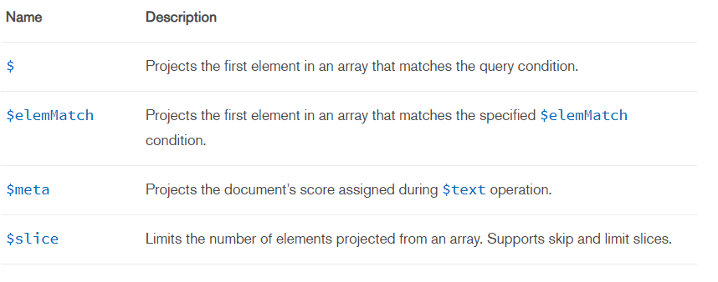
Projection Operators

Slide 22
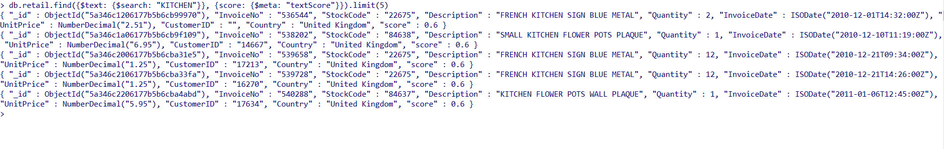
$meta
db.retail.find({$text: {$search: "KITCHEN"}}, {score: {$meta: "textScore"}}).limit(5)
The $meta projection operator returns for each matching document the metadata (e.g. "textScore") associated with the query.
“textScore” returns the score associated with the corresponding $text query for each matching document. The text score signifies how well the document matched the search term or terms. If not used in conjunction with a $text query, returns a score of 0.
For more details refer to Appendix.

Slide 23
Aggregation Operations in MongoDB
Aggregation operations process data records and return computed results.
Aggregation operations group values from multiple documents together, and can perform a variety of operations on the grouped data to return a single result.

Slide 24
Different Ways to Perform Aggregation
Map-Reduce Function
Single Purpose Aggregation Functions
Aggregation Pipeline

Slide 25
Map Reduce
MongoDB provides map-reduce operations to perform aggregation.
In general, map-reduce operations have two phases: a map stage that processes each document and emits one or more objects for each input document, and reduce phase that combines the output of the map operation.
Optionally, map-reduce can have a finalize stage to make final modifications to the result.

Slide 26
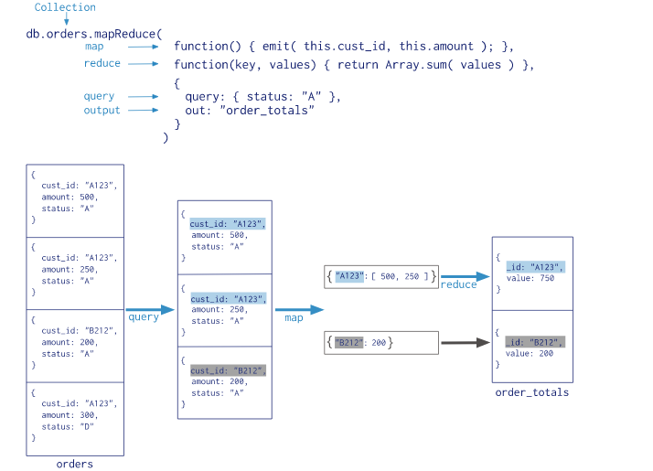
Map Reduce

Slide 27
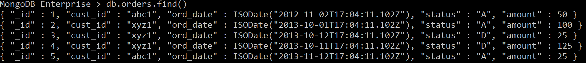
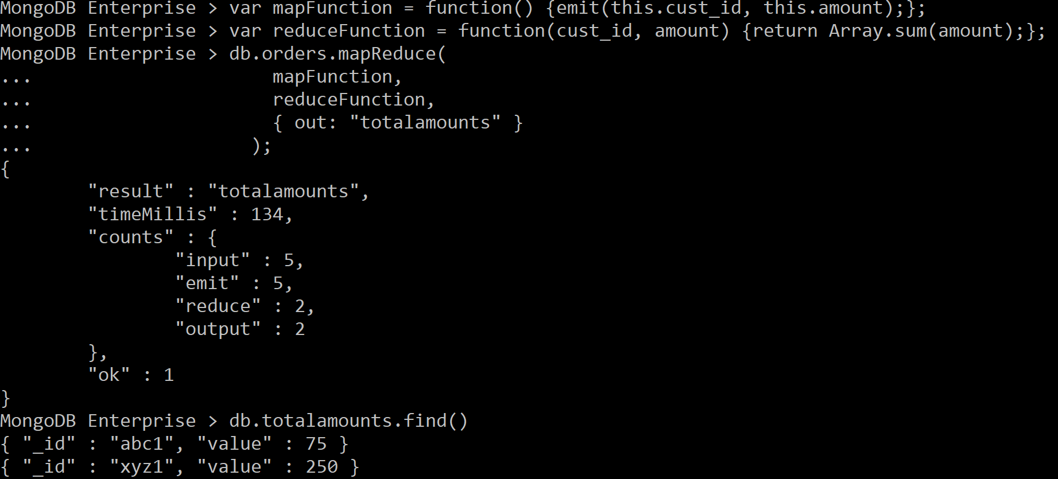
Map-Reduce Example
orders
var mapFunction = function() {emit(this.cust_id, this.amount);};
var reduceFunction = function(cust_id, amount) {return Array.sum(amount);};
db.orders.mapReduce(
mapFunction,
reduceFunction,
{ out: "totalamounts" }
);
Result is in totalamounts collection

Slide 28
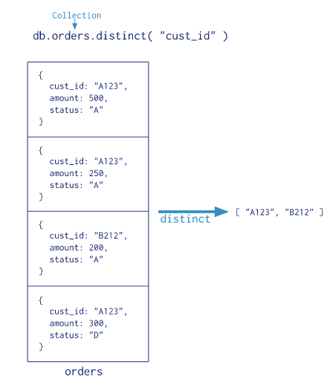
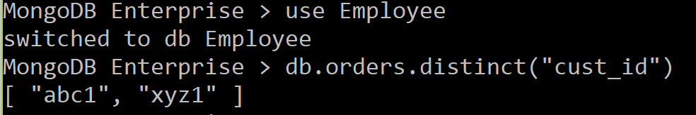
Single Purpose Aggregation Operations
MongoDB also provides db.collection.count() and db.collection.distinct().
All of these operations aggregate documents from a single collection.
While these operations provide simple access to common aggregation processes, they lack the flexibility and capabilities of the aggregation pipeline and map-reduce.

Slide 29
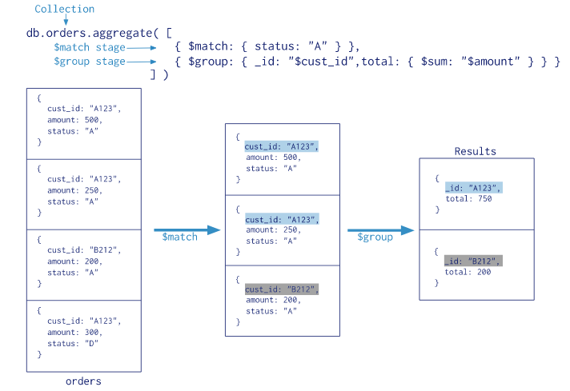
Single Purpose Aggregation Operations

Slide 30
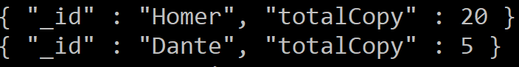
Example
db.createCollection("books")
db.books.insertMany([
{ "_id" : 8751, "title" : "The Banquet", "author" : "Dante", "copies" : 2, },
{ "_id" : 8752, "title" : "Divine Comedy", "author" : "Dante", "copies" : 1, },
{ "_id" : 8645, "title" : "Eclogues", "author" : "Dante", "copies" : 2, },
{ "_id" : 7000, "title" : "The Odyssey", "author" : "Homer", "copies" : 10, },
{ "_id" : 7020, "title" : "Iliad", "author" : "Homer", "copies" : 10, },
])
db.books.aggregate(
[
{ $group : { _id : "$author", books: { $push: "$title" } } }
]
)
db.books.aggregate(
[
{$group : {_id:"$author", totalCopy: { $sum: "$copies"}}},
{$sort:{totalCopy:-1} }
]
)

Slide 31
Aggregation Pipeline Framework
MongoDB’s aggregation framework is modeled on the concept of data processing pipelines.
Documents enter a multi-stage pipeline that transforms the documents into an aggregated result.
The pipeline provides efficient data aggregation using native operations within MongoDB, and is the preferred method for data aggregation in MongoDB.

Slide 32
Pipeline Expressions
Some of the pipeline stages take a pipeline expression as the operand.
Pipeline expressions specify the transformation to apply to the input documents.
These expressions have a document structure and can contain other expression.
They can only operate on the current document in the pipeline and cannot refer to data from other documents: expression operations provide in-memory transformation of documents.

Slide 33
Common Pipeline Stages and Behavior
“Aggregate” command operates on a single collection, logically passing the entire collection into the aggregation pipeline.
$match, $limit, and $skip stages can be used to restrict the documents that enter at the beginning of the pipeline
$match and $sort pipeline operators can take advantage of an index when they occur at the beginning of the pipeline.
We will further see an example of these aggregation stages as part of aggregation pipelines for a sample dataset.
Refer to the Appendix for a list of all aggregation Pipeline Stages

Slide 34
Common Pipeline Stages and Behavior
A Sample Aggregation Pipeline Framework
Match
Project
Group
Sort
Out
The match stage can be used to reduce document count.
It is generally used as the first stage in a pipeline and uses indexes.
The project stage is used to vertically slice a document.
It can be used to remove or add fields.
The group stage is used for the aggregation task i.e. sum, avg, etc.
The sort stage is used for ordering the documents in an ascending/descending manner.
The Out stage can be used as a final stage of the pipeline to output the results to a new collection.
If the name specified is of a collection that already exists, out will overwrite it.
db.story.aggregate(
[ { $match : { author : “Jane" } } ]
);
db.story.aggregate(
[ {$project : { title : 1 , author : 1 }} ]
);
*1 – keep, 0 – leave out
db.story.aggregate(
[ {$group : {_id : “$author”,
count: { $sum: 1 }}
} , {$sort : {count: -1}}
]
);
db.story.aggregate( [
{ $group : { _id : "$author", books: { $push: "$title" } } },
{ $out : "authors" }
] )

Slide 35
Aggregation Pipeline Operators
The following types of pipeline operators are available in MongoDB to construct expressions for use in aggregation pipeline stages.
Arithmetic Expression Operators | Object Expression Operators
Array Expression Operators | Set Expression Operators
Boolean Expression Operators | String Expression Operators
Comparison Expression Operators | Text Expression Operators
Conditional Expression Operators | Type Expression Operators
Date Expression Operators | Accumulators
Literal Expression Operators | Variable Expression Operators

Slide 36
Aggregation Pipeline Operators
Arithmetic Expression Operators
$abs, $add, $ceil, $multiply …
Array Expression Operators
$arrayElemAt, $arrayToObject, $in, $map, $reduce …
Boolean Expression Operators
$and, $not, $or
Comparison Expression Operators
$eq, $gt, $gte …
Conditional Expression Operators
$cond, $ifNull, $switch
Date Expression Operators
$dateFromParts, $dateFromString, $hour, $dayOfWeek …
Set Expression Operators
$allElementsTrue, $anyElementTrue, $setEquals …

Slide 37
Aggregation Pipeline Operators
String Expression Operators
$concat, $ltrim, $rtrim …
Type Expression Operators
$convert, $toBool, $toDate …
Accumulators
$avg, $max, $min …
Variable Expression Operators
$let
For details please visit: https://docs.mongodb.com/manual/reference/operator/aggregation/

Slide 38
Aggregation Pipeline Restrictions
Result Size Restrictions
The aggregate command returns either a cursor or store the results in a collection
When returning a cursor or storing the results in a collection, each document in the result set is subject to the BSON Document Size limit (16 megabytes)
Memory Restrictions
Pipeline stages have a limit of 100 megabytes of RAM. If a stage exceeds this limit, MongoDB will produce an error.
To allow for the handling of large datasets, use the allowDiskUse option to enable aggregation pipeline stages to write data to temporary files.

Slide 39
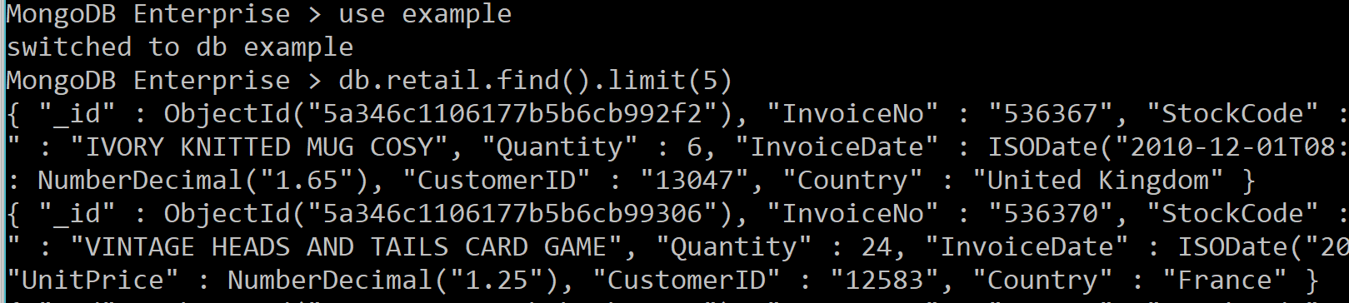
MongoDB Aggregation Example
Let’s take the retail example before

Slide 40
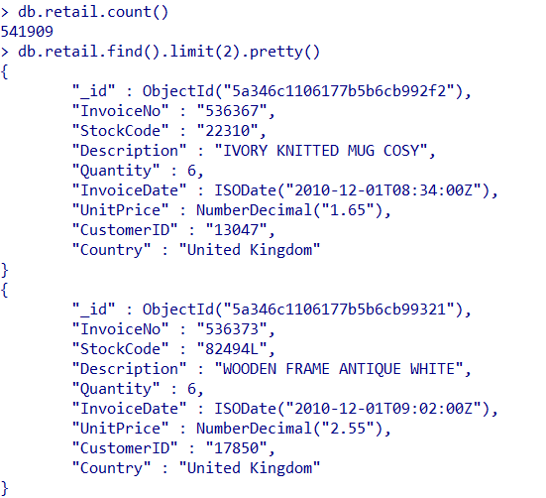
MongoDB Aggregation Example
We now explore the retail collection by counting the number of records and viewing a few documents to observe the structure of data
db.retail.count()
db.retail.find().limit(2).pretty()
We use .count() and .find() to do the same.
We use .limit() and .pretty() to make the output results more readable.

Slide 41
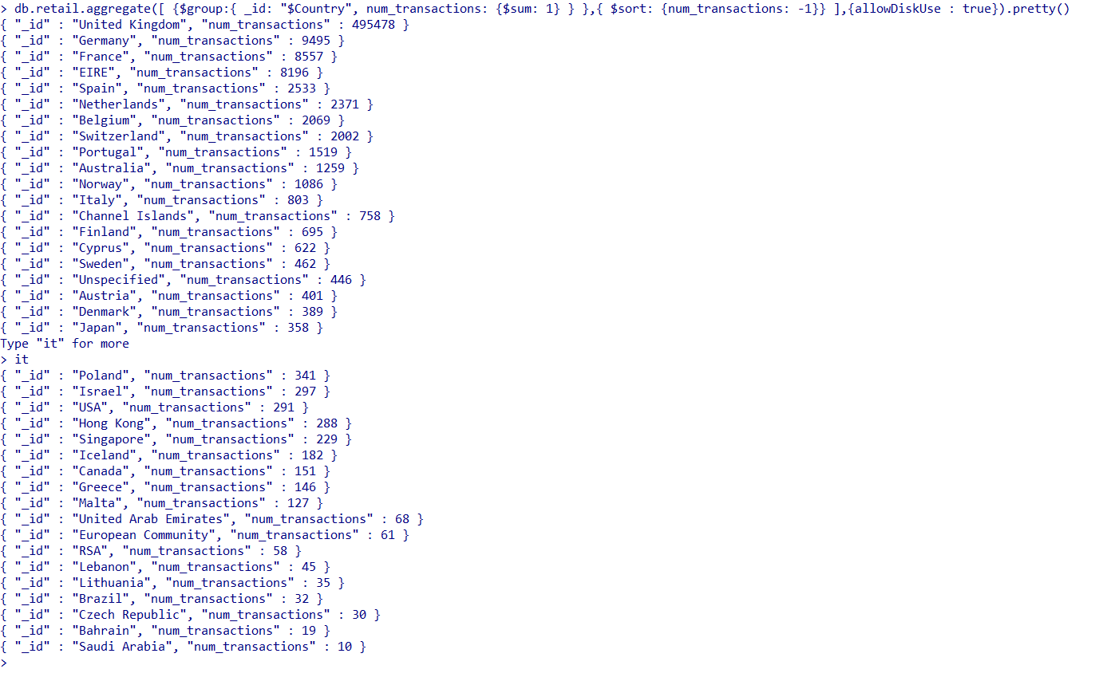
Next we explore one of the fields in the collection – Country. Here we see overall distribution of invoices/item transactions by country.
db.retail.aggregate([{$group:{_id: "$Country", num_transactions: {$sum: 1}}}, {$sort: {num_transactions: -1}}], {allowDiskUse: true}).pretty()
To do this, we use $group aggregation stage and $sum operator.
We sort the output results in a descending order using $sort.
We also use allowDiskUse as the size of our collection is quite large (~540K records)

Slide 42
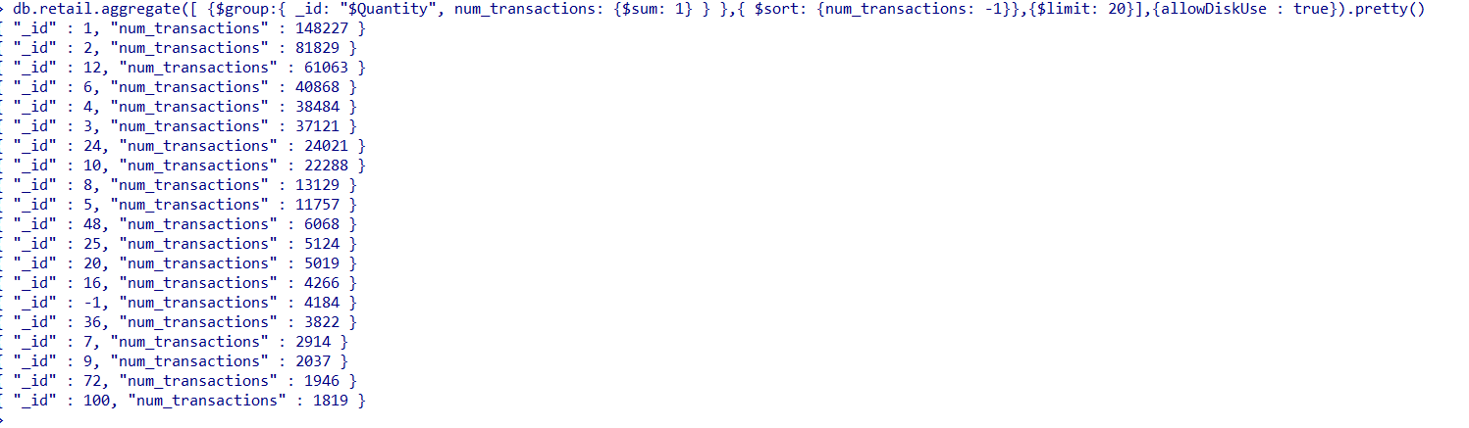
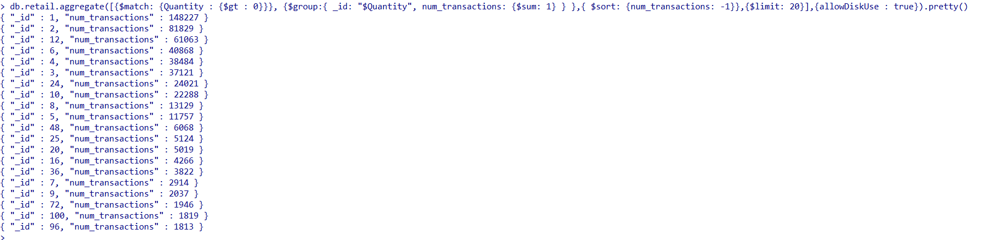
Now, we see overall distributions by quantity of items bought in a transaction. In our first result, we observe negative values of Quantity and so we apply a filter to get rid of those values first.
db.retail.aggregate([{$group:{_id: "$Quantity", num_transactions: {$sum: 1}}}, {$sort: {num_transactions: -1}}, {$limit: 20}], {allowDiskUse: true}).pretty()
The filter can be applied by introducing a $match stage at the beginning of the pipeline
db.retail.aggregate([{$match: {Quantity: {$gt : 0}}}, {$group:{_id: "$Quantity", num_transactions: {$sum: 1}}}, {$sort: {num_transactions: -1}}, {$limit: 20}],
{allowDiskUse: true}).pretty()

Slide 43
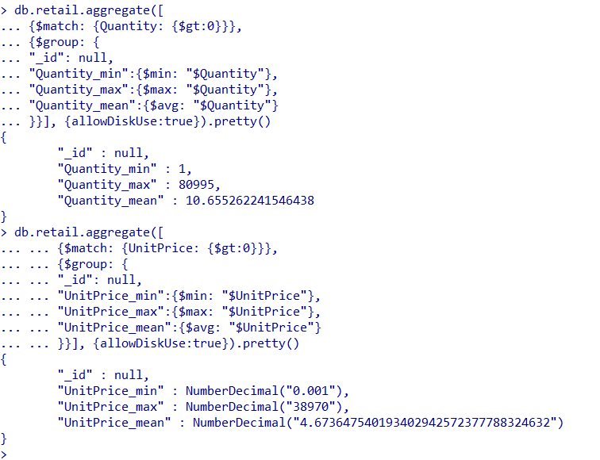
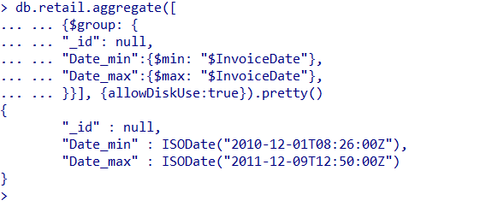
We check the overall minimum, maximum and average quantity value and cost of items. We also see the minimum and maximum dates in the dataset.
db.retail.aggregate([
{$match: {Quantity: {$gt: 0}}},
{$group: {
"_id": null,
"Quantity_min":{$min : "$Quantity"},
"Quantity_max":{$max : "$Quantity"},
"Quantity_mean":{$avg : "$Quantity"}
}}], {allowDiskUse : true}).pretty()
db.retail.aggregate([
{$group: {
"_id": null,
"Date_min":{$min : "$InvoiceDate"},
"Date_max":{$max : "$InvoiceDate"}
}}], {allowDiskUse : true}).pretty()
We use the $min, $max and $avg operators for these operations.
The $group stage is used to perform all these aggregations and return the results
db.retail.aggregate([
{$match: {UnitPrice: {$gt: 0}}},
{$group: {
"_id": null,
"UnitPrice_min":{$min : "$UnitPrice"},
"UnitPrice_max":{$max : "$UnitPrice"},
"UnitPrice_mean":{$avg : "$UnitPrice"}
}}], {allowDiskUse : true}).pretty()

Slide 44
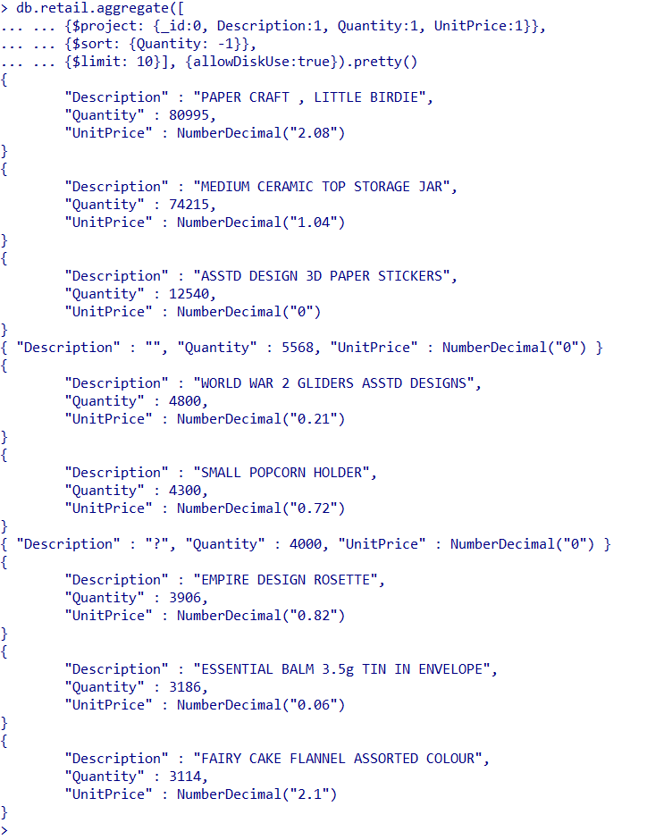
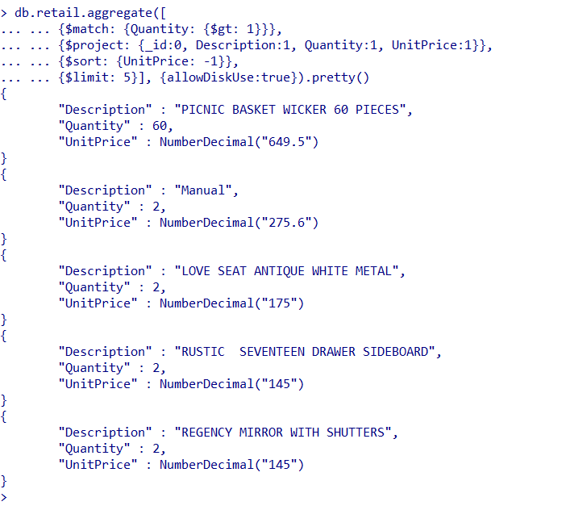
MongoDB Example
We now see the top items bought (according to quantity and price)
db.retail.aggregate([
{$project: {_id:0, Description:1, Quantity:1, UnitPrice:1}},{$sort: {Quantity: -1}}, {$limit: 10}], {allowDiskUse : true}).pretty()
db.retail.aggregate([
{$match: {Quantity: {$gt: 1}}},
{$project: {_id:0, Description:1, Quantity:1, UnitPrice:1}},{$sort: {UnitPrice: -1}}, {$limit: 5}], {allowDiskUse : true}).pretty()
Here we are using the $project stage to display only the few relevant fields and the $sort stage to order the documents according to quantity/price.
We use $limit to limit the output to the top 10 and 5 records

Slide 45
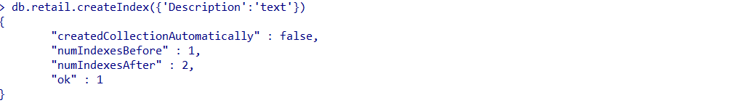
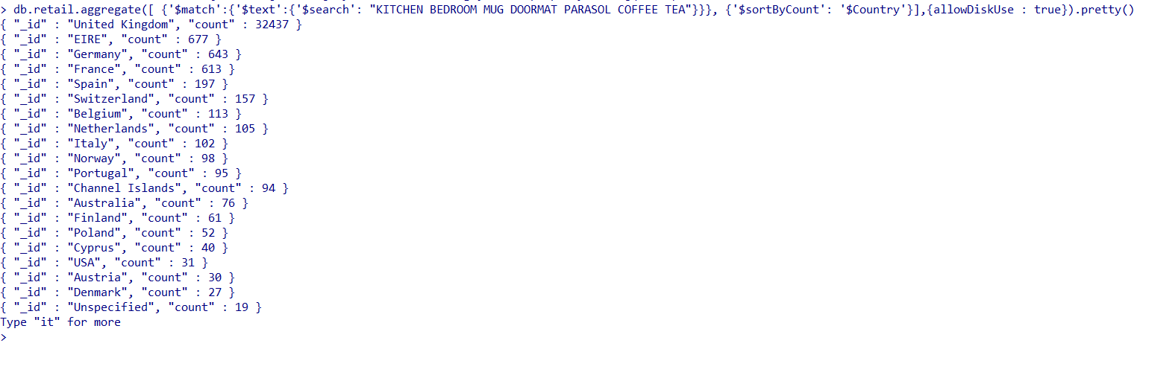
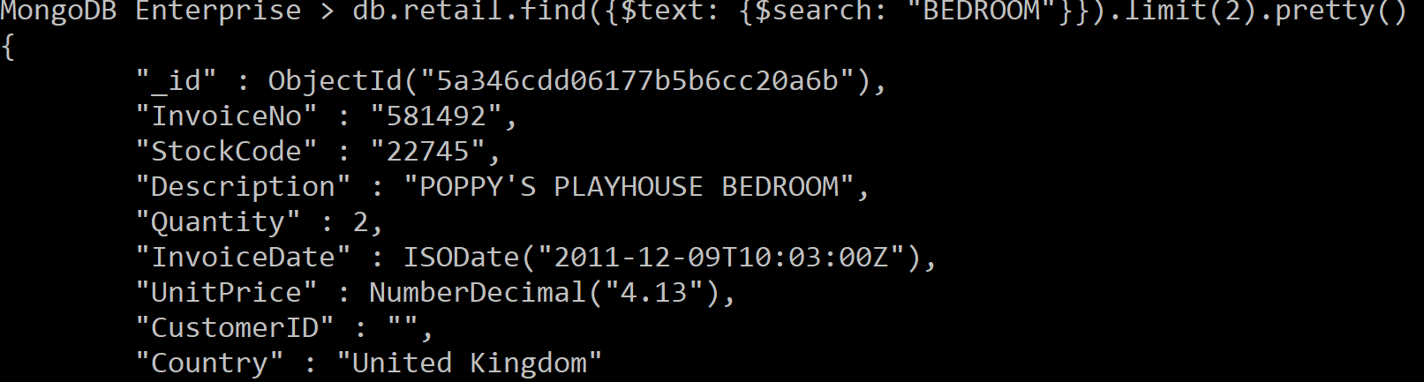
Here we use the text search feature in MongoDB to sort countries according to customer transactions with item names related to household items
As mentioned earlier, we first define a text index for ‘Description’
Then, we use the $text stage within $match to search and retain all documents with item descriptions containing KITCHEN, BEDROOM, MUG, DOORMAT, PARASOL, COFFEE or TEA
Finally, we use the $sortByCount stage to count these records by Country and sort them accordingly
db.retail.createIndex({'Description' : 'text'})
db.retail.aggregate([{'$match':{'$text':{'$search': "KITCHEN BEDROOM MUG DOORMAT PARASOL COFFEE TEA"}}},{'$sortByCount':'$Country'}],{allowDiskUse:true}).pretty()

Slide 46
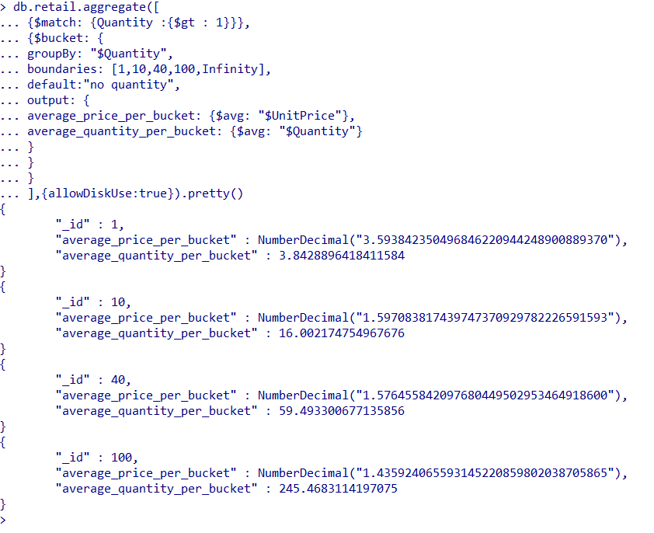
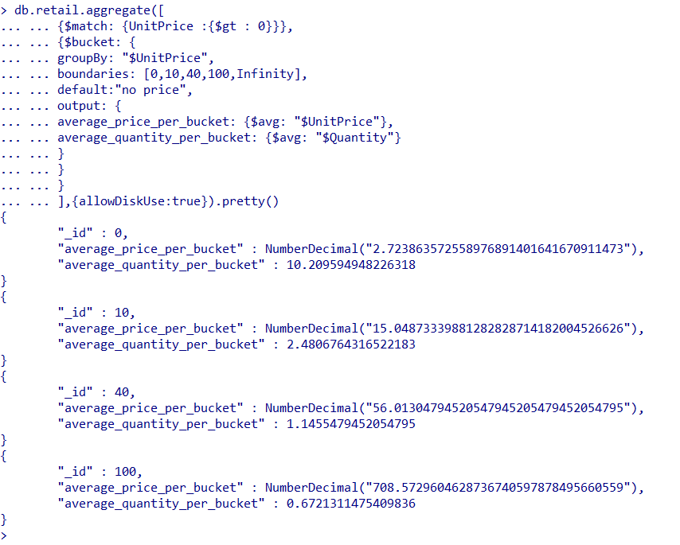
Here we use the ‘bucket’ aggregation stage to observe relationships between quantity and price. As expected, we see expensive items being purchased in lower quantities.
db.retail.aggregate([
{$match: {Quantity: {$gt : 1}}},
{$bucket: {
groupBy: "$Quantity",
boundaries: [1,10,40,100, Infinity],
default: "no quantity",
output: {
average_price_per_bucket: {$avg: "$UnitPrice"},
average_quantity_per_bucket: {$avg: "$Quantity"}
}}}], {allowDiskUse:true}).pretty()
db.retail.aggregate([
{$match: {UnitPrice: {$gt : 0}}},
{$bucket: {
groupBy: "$UnitPrice",
boundaries: [0,10,40,100, Infinity],
default: "no price",
output: {
average_price_per_bucket: {$avg: "$UnitPrice"},
average_quantity_per_bucket: {$avg: "$Quantity"}
}}}], {allowDiskUse:true}).pretty()
The $bucket stage aggregates data into bins specified by the value provided in groupBy and using the boundaries provided. The default value is used to place records not falling within any of the bins. The output parameter is used to specify what aggregations are required e.g. avg, sum, etc.

Slide 47
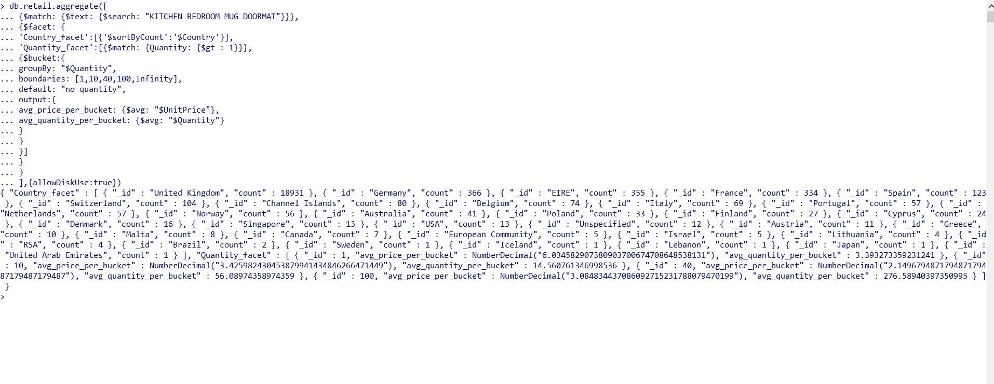
Here we use the ‘facet’ aggregation stage to group multiple queries and present multiple facets at once. We can see that the facet stage includes two stages within : one consisting of the transaction count by country and the other consisting of the quantity ‘buckets’ we saw on the previous slide.
db.retail.aggregate([
{$match: {$text: {$search: "KITCHEN BEDROOM MUG DOORMAT"}}},
{$facet: {
'Country_facet': [{'$sortByCount' : '$Country'}],
'Quantity_facet': [{$match: {Quantity: {$gt : 1}}},
{$bucket: {
groupBy: "$Quantity",
boundaries: [1,10,40,100, Infinity],
default: "no quantity",
output: {
average_price_per_bucket: {$avg: "$UnitPrice"},
average_quantity_per_bucket: {$avg: "$Quantity"}
}}}]
}}], {allowDiskUse:true})
$facet enables us to execute multi-faceted aggregations. Here for example, you first get the entire Country_facet as the output and then the Quantity_facet.

Slide 48
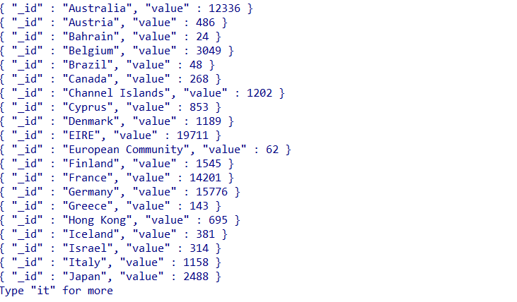
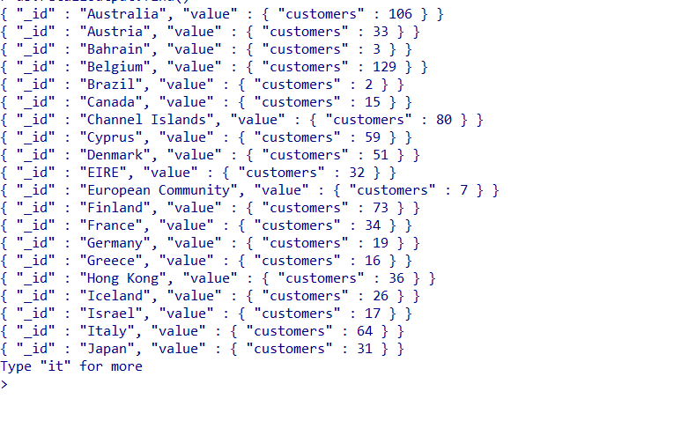
Aggregation operations can also be performed via Map Reduce in MongoDB.
Example 1: count of customers per country
Example 2: Sum of item quantities per country
var map = function() {
emit(this.Country, {customers: this.CustomerID});
}
var reduce = function(key, values) {
var sum = 0;
values.forEach(function(doc) {
sum += 1;
});
return {customers: sum};
}
db.retail.mapReduce(map, reduce, {out: "retailoutput"});
db.retailoutput.find()
var map2 = function() {
emit(this.Country, this.Quantity);
};
var reduce2 = function(key, values) {
return Array.sum(values);
};
var op3 = db.retail.mapReduce(map2, reduce2, {out: "retailoutput2"});
db.retailoutput2.find()
The map phase returns specified key-value pairs.
The reduce phase collects and condenses the aggregate data.
‘out’ is then used to output the final results as a new collection.

Slide 49
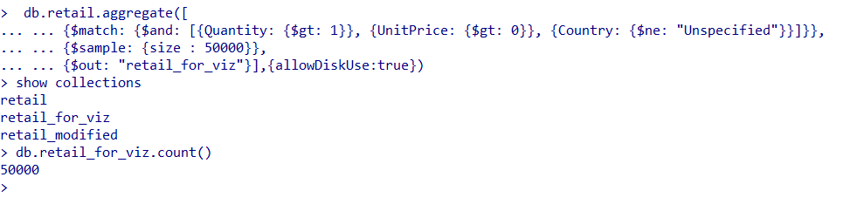
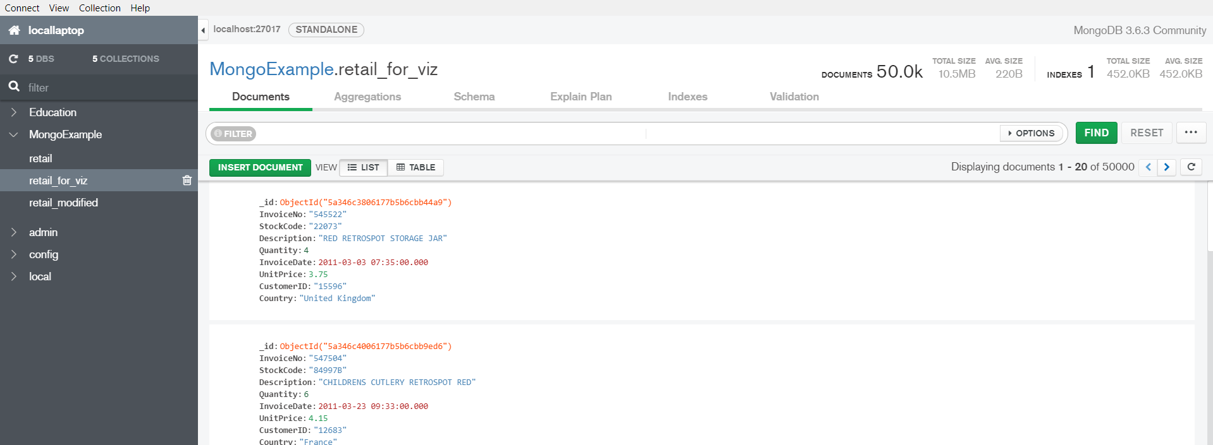
We now reduce the dataset to the relevant records and export a sample for further visualizations in Tableau
db.retail.aggregate([
{$match: {$and: [{Quantity: {$gt: 1}}, {UnitPrice: {$gt: 0}}, {Country: {$ne: "Unspecified"}}]}},
{$sample: {size: 50000}},
{$out: "retail_for_viz"}], {allowDiskUse: true})
show collections
db.retail_for_viz.count()
The output collection as viewed in MongoDB Compass
$sample stage is used to obtain a smaller sample for Tableau as our data size is very large.
$out stage outputs the results to a new collection

Slide 50
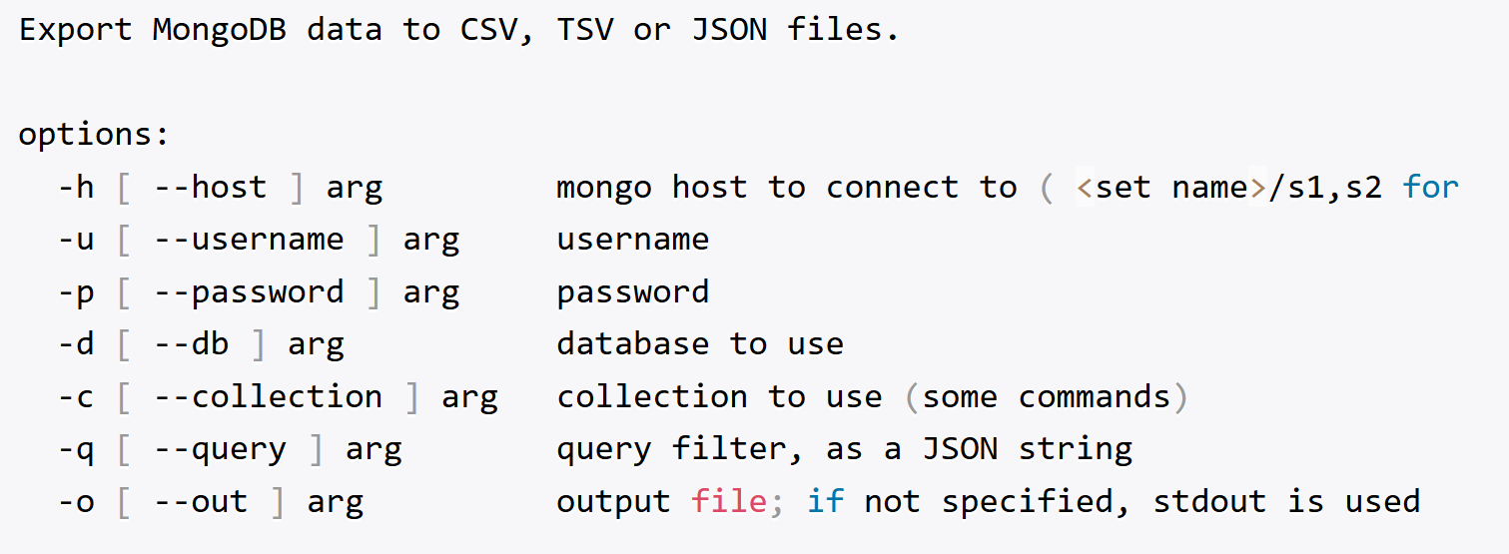
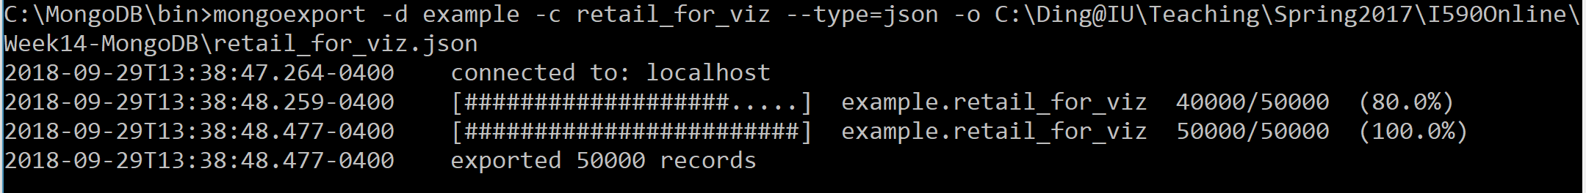
Export
mongoexport

Slide 51
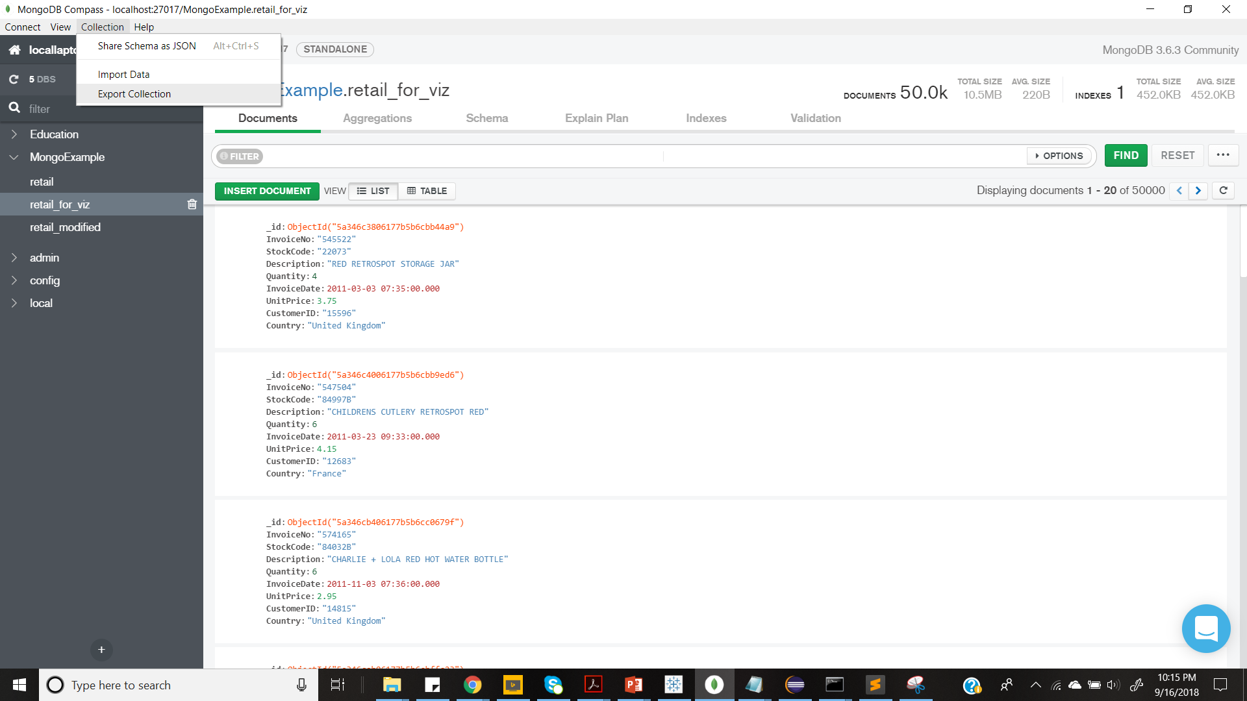

Here we are using the Compass GUI to export the sample collection (mongoexport can also be used: https://docs.mongodb.com/manual/reference/program/mongoexport/)
We first click the Export Collection in the Collection tab
Then, we specify the type of output file and the destination location

Slide 52

Finally, we use the extracted sample data to create some exploratory visualizations in Tableau
Tableau is a visualization tool that can be used to connect to almost any database and drag and drop to create interactive visualizations.
Tableau Public can be installed from the following link:
https://public.tableau.com/en-us/s/
Tableau Public currently allows connections to only a few types of files (including excel and json) and servers

Slide 53

Tableau Visualization
The data file can be loaded in Tableau using its Connect feature
We load our output json file into Tableau using the JSON file option.
We can also output our collection as a .csv file and save it as an excel to load into Tableau (if the size permits)
After connecting with the file, select schema items, then click return
Then, go to sheet1

Slide 54

Post this, we create our first worksheet as follows:
This section displays the commonly used charts in Tableau. For this visualization we are using a bubble chart
This section displays the dimensions/qualitative data in our collection
Here we specify the fields used in the chart – for size, color, details mentioned, etc.
This section displays the measures/quantitative data in our collection
This is a set of the top 10 items by total unit price created for our use. Tableau includes many such features to group data.

Slide 55

We create four worksheets displaying different exploratory analyses in Tableau – Average Items purchased (Country-wise), Top 10 items by Total Unit Price and Price & Quantity monthly trends for these top 10 items.
Eventually we consolidate these sheets into two dashboards and one storyboard.
This dashboard includes the sheets with the average items per country and top 10 items views

Slide 56

We create four worksheets displaying different exploratory analyses in Tableau – Average Items purchased (Country-wise), Top 10 items by Total Unit Price and Price & Quantity monthly trends for these top 10 items.
Eventually we consolidate these sheets into two dashboards and one storyboard.
This dashboard includes the sheets with the monthly trends

Slide 57


We create four worksheets displaying different exploratory analyses in Tableau – Average Items purchased (Country-wise), Top 10 items by Total Unit Price and Price & Quantity monthly trends for these top 10 items.
Eventually we consolidate these sheets into two dashboards and one storyboard.
The final storyboard contains both the dashboards for easy viewing

Slide 58


Please use the given link to further explore the Tableau dashboards/storyboard: MongoDB Retail Example Workbook

Slide 59
References
MongoDB documentation: https://docs.mongodb.com/manual/
MongoDB Compass documentation: https://docs.mongodb.com/compass/master/

Slide 60
Appendix : MongoDB Compass
MongoDB Compass acts as a GUI for MongoDB.
Through Compass, you can visually explore your dataset and view and optimize your query performance.
The Compass GUI is available as an option while installing MongoDB

Slide 61

Connecting in MongoDB Compass
You can connect to MongoDB Compass on your localhost using the ‘New Connection’ option and specifying the following parameters.

Slide 62

Connecting in MongoDB Compass
You can connect to an outside cluster on MongoDB Atlas using the following format

Slide 63


On connecting, you will be able to see the following options for visualizing your data and querying via MongoDB Compass
Data can be imported into collections or exported out of collections using the “Import Data” and “Export Collections” options under the Collections tab

Slide 64

On connecting, you will be able to see the following options for visualizing your data and querying via MongoDB Compass
List of databases with their storage size, number of collections and indexes

Slide 65

On connecting, you will be able to see the following options for visualizing your data and querying via MongoDB Compass
Options for viewing documents in the collections present in the database.

Slide 66

On connecting, you will be able to see the following options for visualizing your data and querying via MongoDB Compass
Schema Analyzer – Which displays a summary of the features and distribution of the attributes within the dataset.

Slide 67

On connecting, you will be able to see the following options for visualizing your data and querying via MongoDB Compass
Schema Analyzer – Attributes of types array/documents can be viewed with all their nested fields.

Slide 68

On connecting, you will be able to see the following options for visualizing your data and querying via MongoDB Compass
Schema Analyzer – Geospatial variables can be viewed and explored in the Schema Analyzer as well.

Slide 69

On connecting, you will be able to see the following options for visualizing your data and querying via MongoDB Compass
Schema Analyzer – Geospatial variables can be viewed and explored in the Schema Analyzer as well.

Slide 70

On connecting, you will be able to see the following options for visualizing your data and querying via MongoDB Compass
Create and display unique indexes in the collection.

Slide 71

On connecting, you will be able to see the following options for visualizing your data and querying via MongoDB Compass
Run different aggregation stages and obtain a preview of what the data would look like after each stage.
New stages can be added to the pipeline using “Add Stage”. The final pipeline can be built and saved by entering the pipeline name at the top and using “Save Pipeline”.

Slide 72


Other options available in MongoDB Compass are Validation and Explain Plan
Explain Plan can be used to view the execution Plan and Performance Summary for a query filter
Validation can be used to provide rules to perform schema validation during updates and insertions.

